Slide 1
Using unsupervised learning in search of new physics
Sakarias Garcia de Presno Frette

Slide 2
Master thesis
Attempt to see if the auto encoder can learn, without copying, to reconstruct sm processes and filter out new physics
If anomalies are found they will be compared to two new models, heavy neutrinos and heavy right handed W bosons
Compare with supervised results

Slide 3
Using auto encoder for anomaly detection with ATLAS open data
Attempt to see if the auto encoder can learn, without copying, to reconstruct sm processes and filter out new physics
Test against new physics models

Slide 4
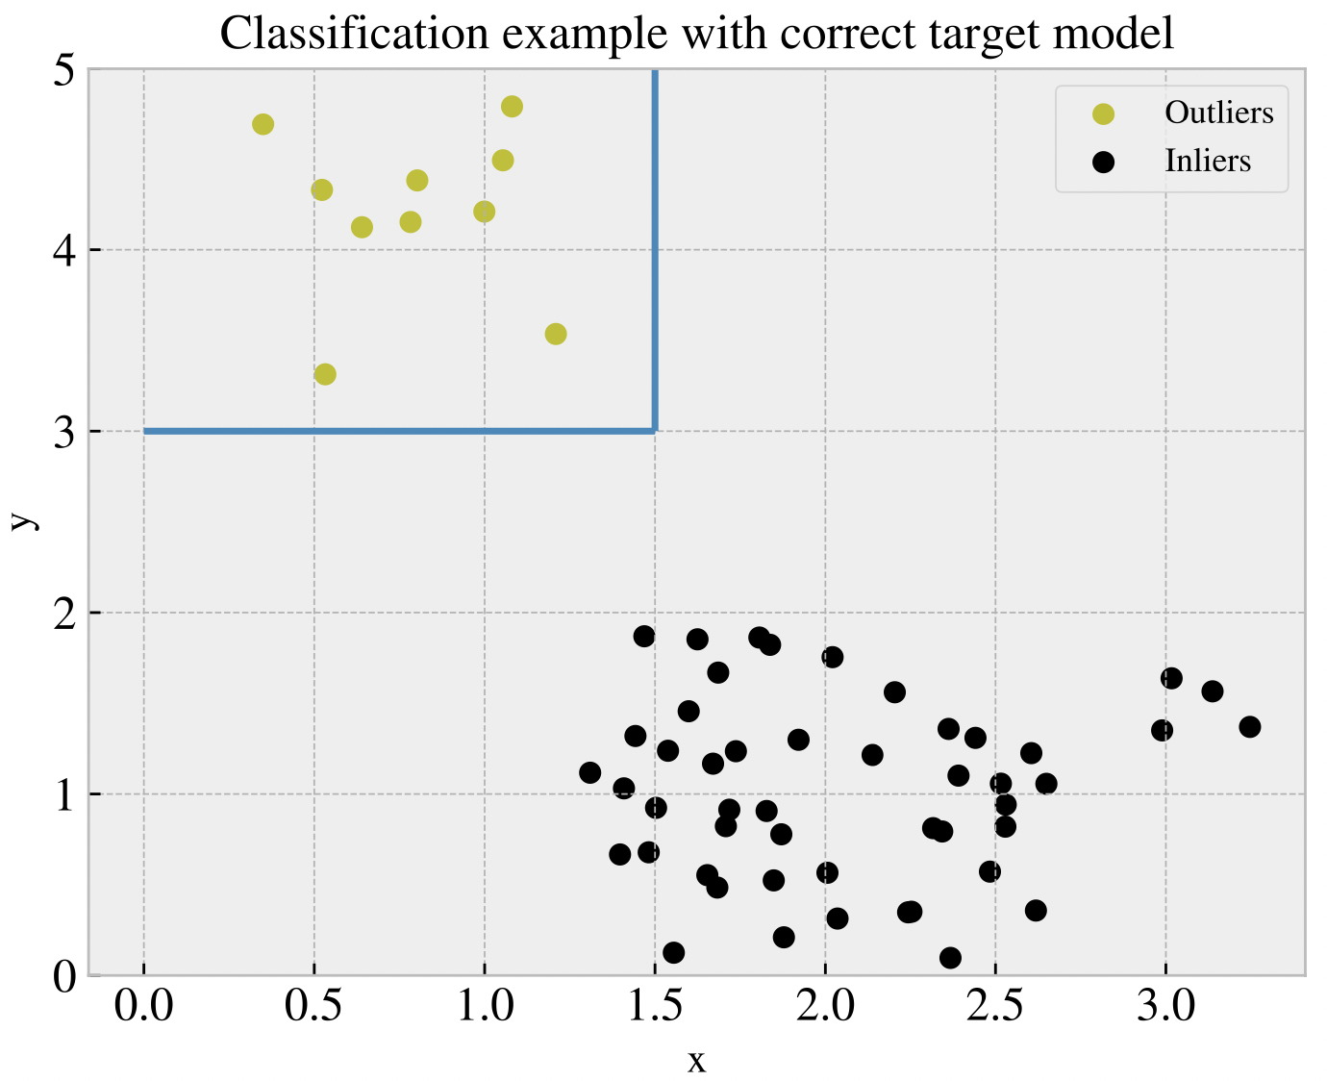
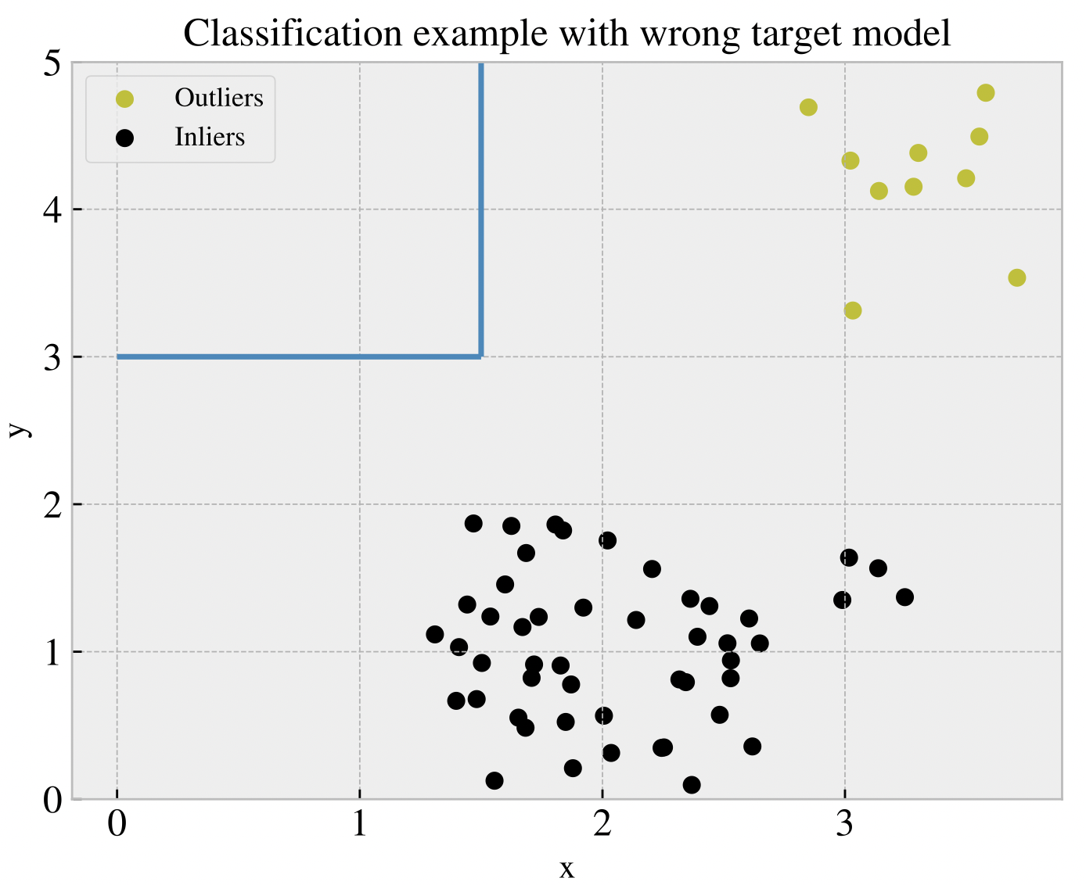
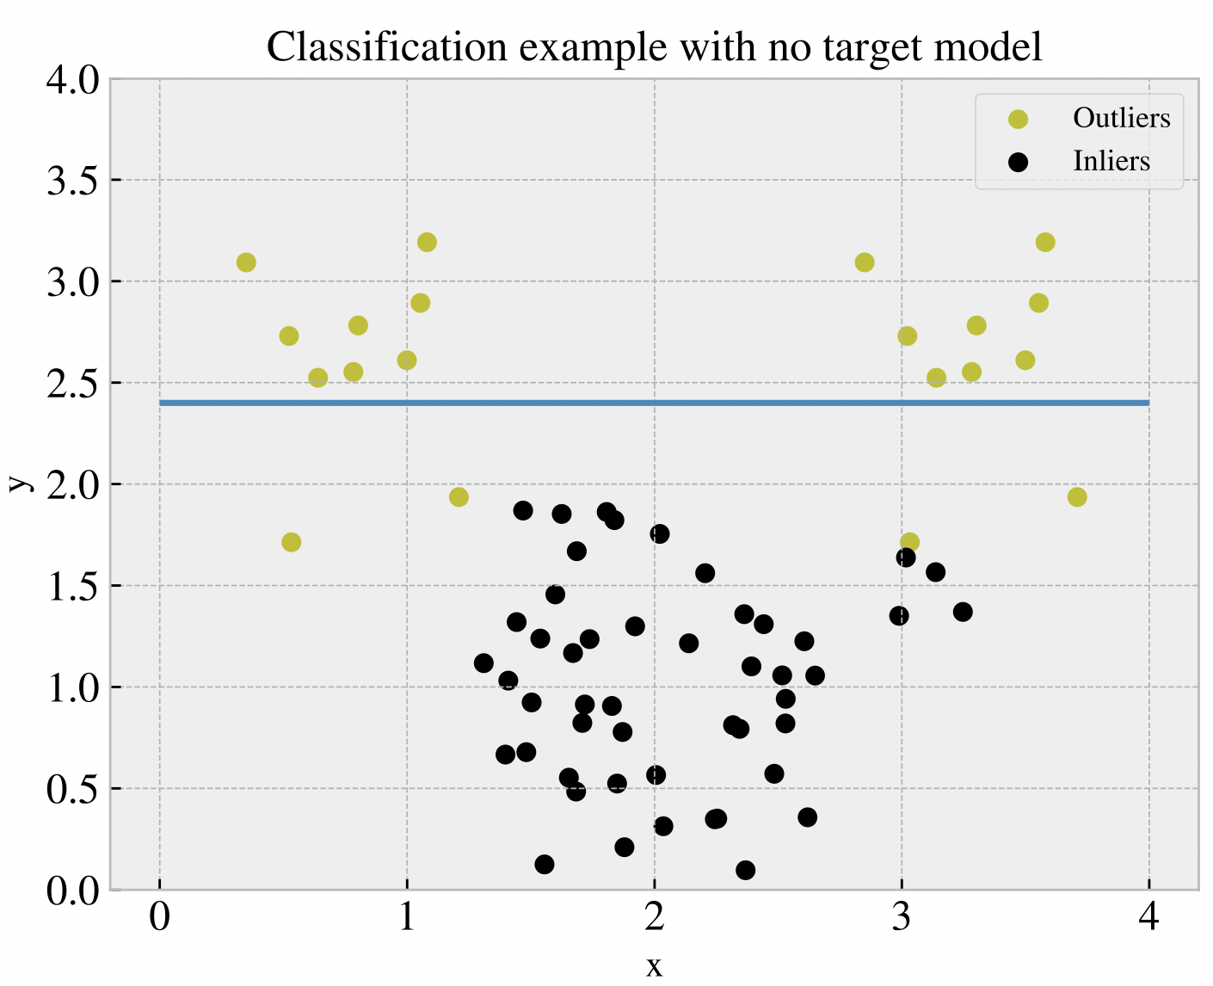
Anomaly detection

Slide 5
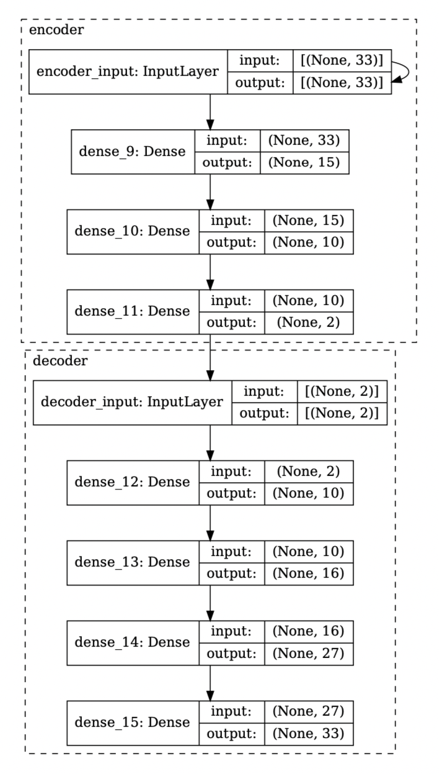
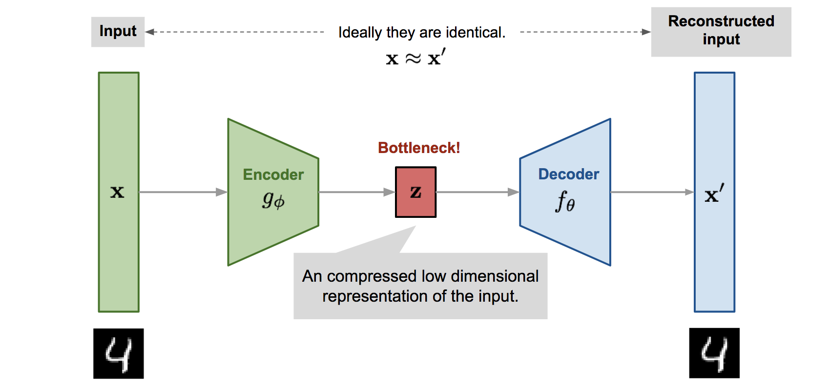
Auto Encoders
Reconstruction
Hyper parameters
Source: https://lilianweng.github.io/posts/2018-08-12-vae/

Slide 6
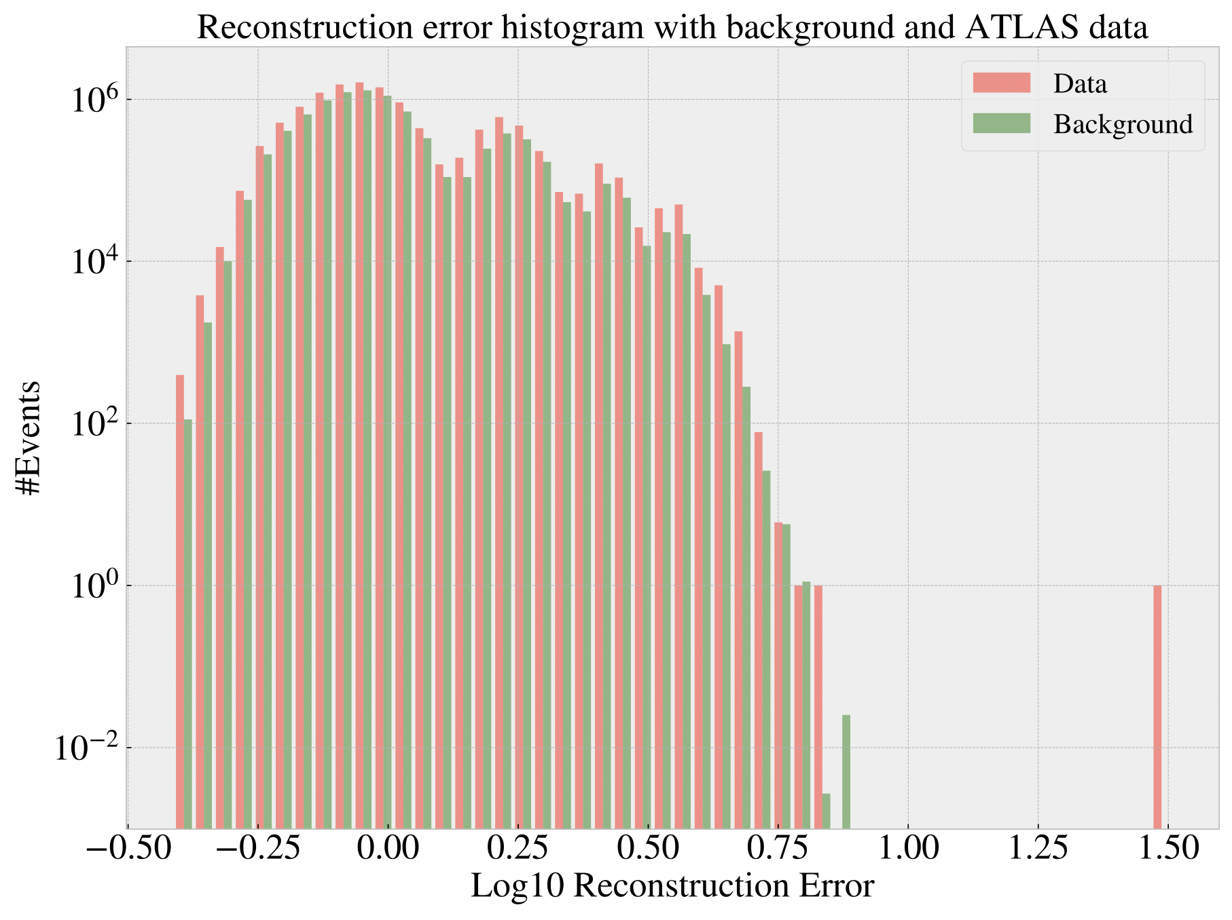
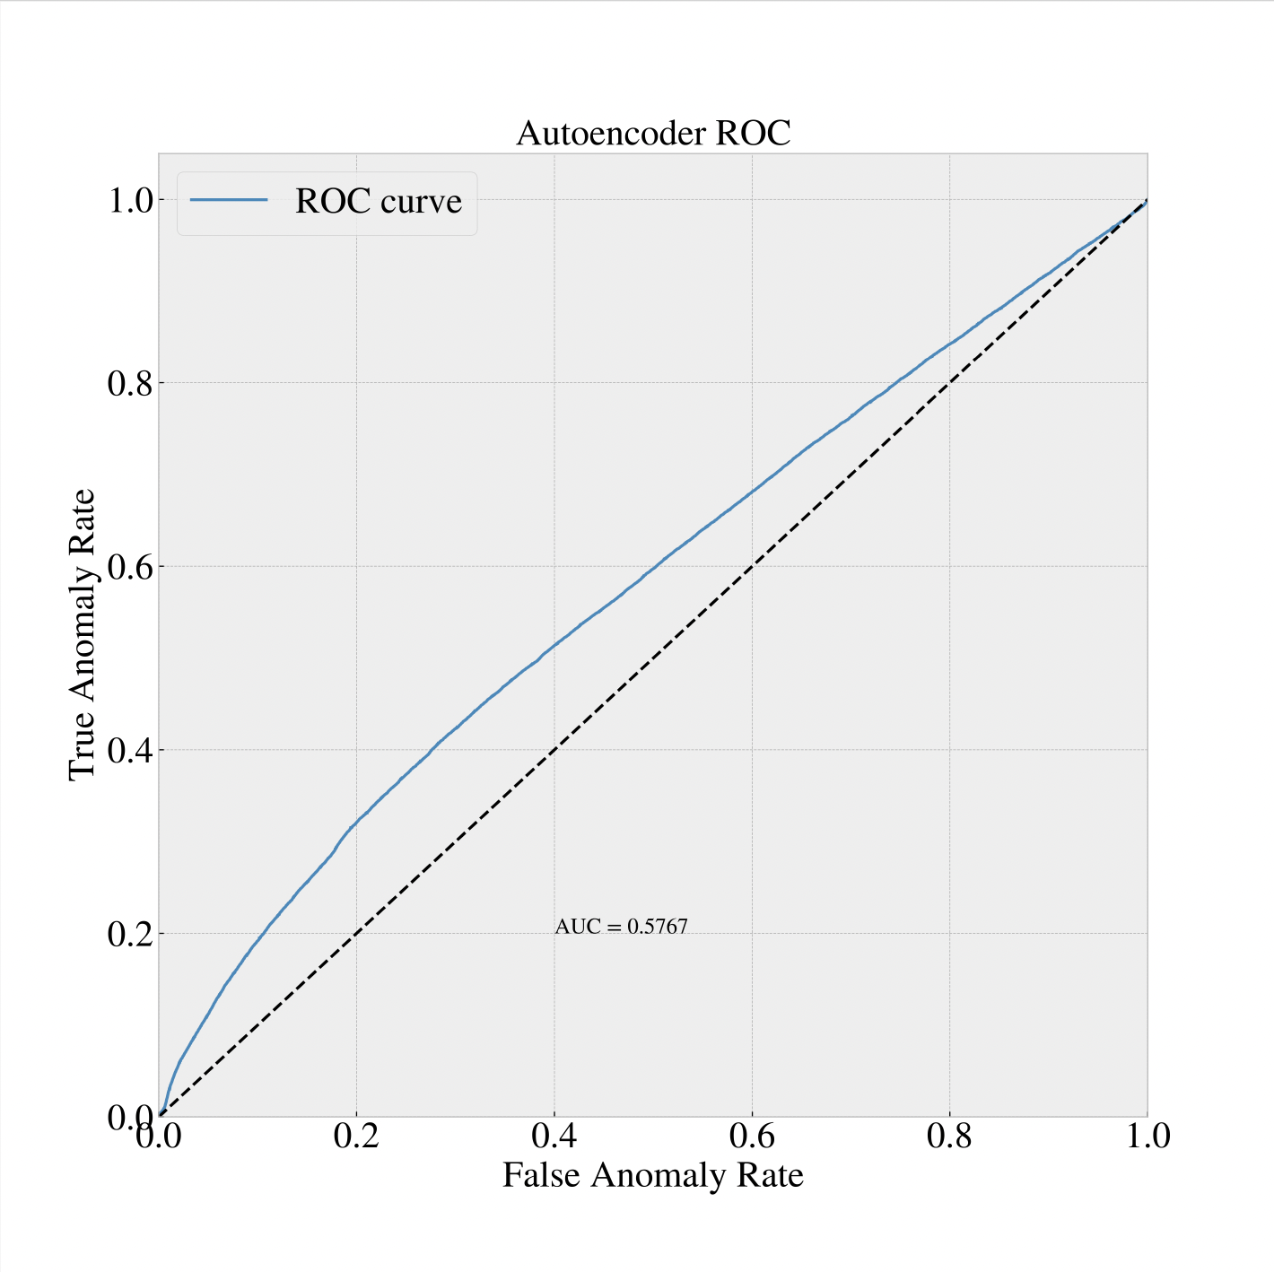
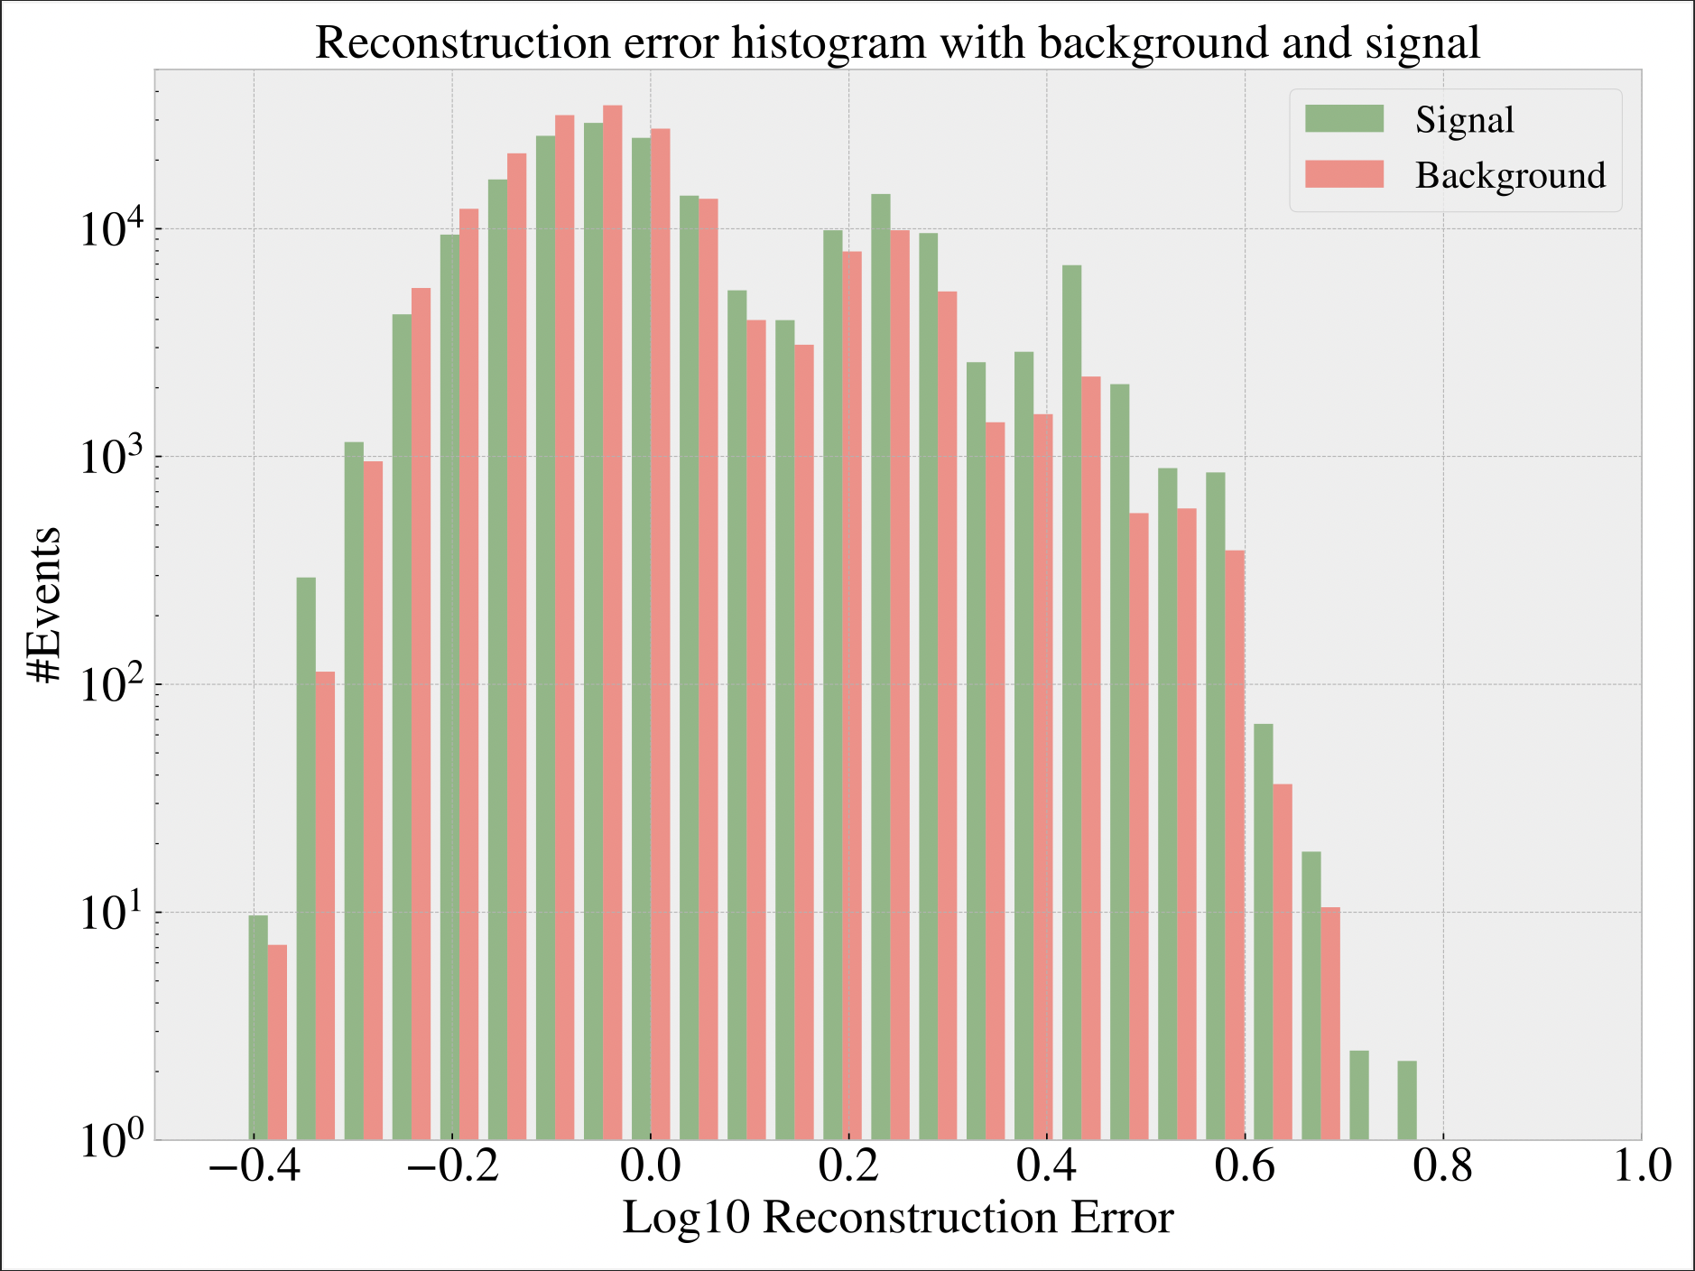
Results

Slide 7
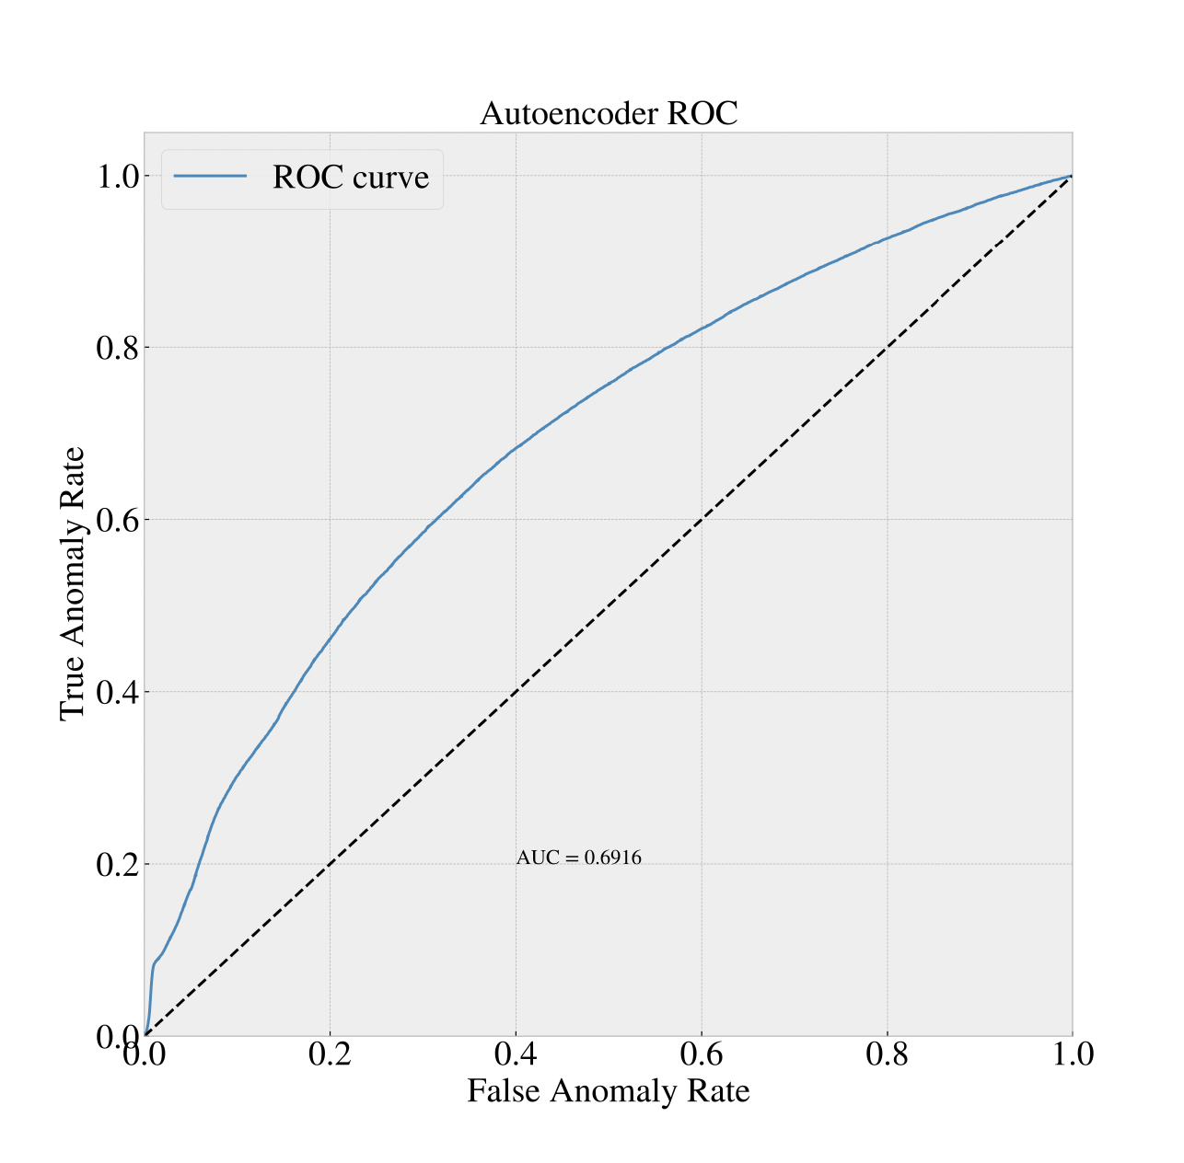
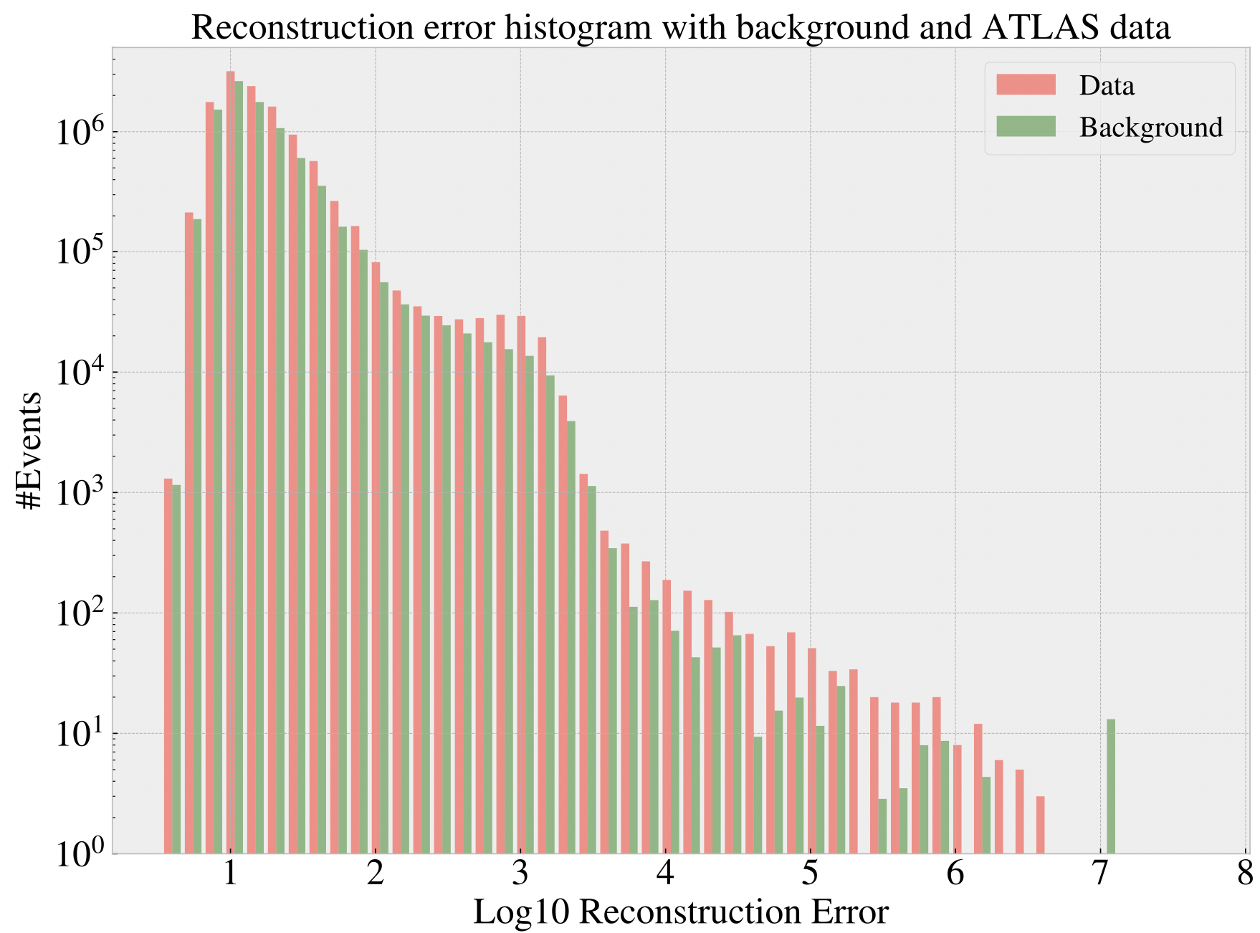
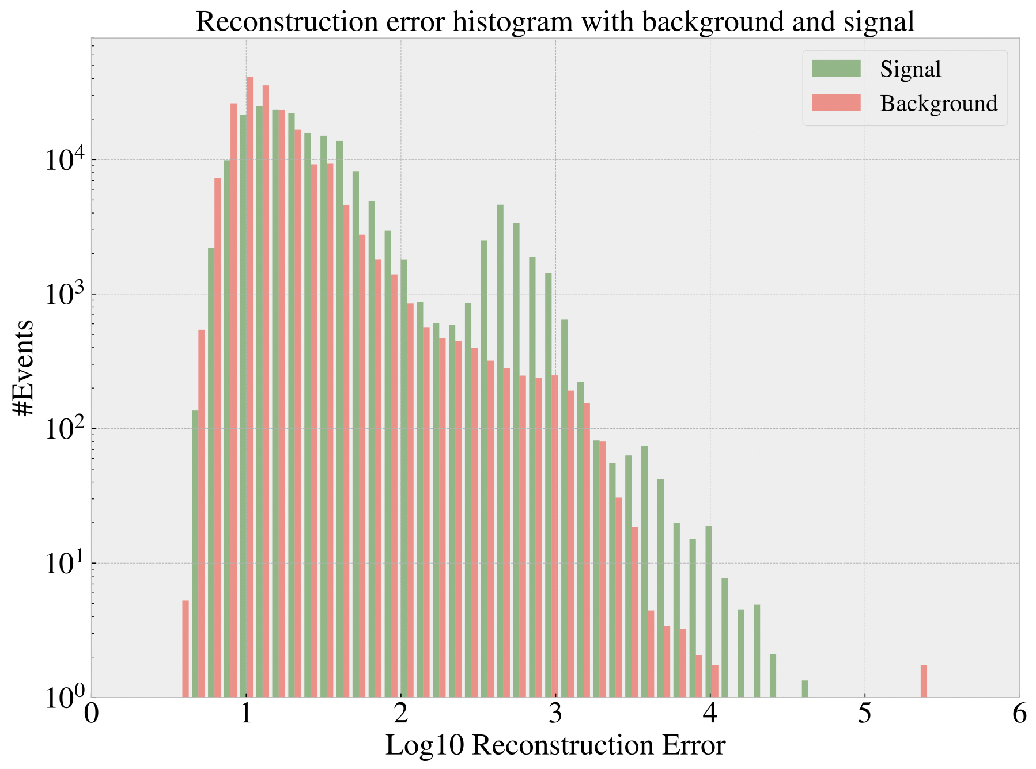
More results

